Slide 1
ML PROJECT · CUSTOMER SEGMENTATION
Customer Segmentation
Using K-Means
Clustering
An Unsupervised Machine Learning
Jackson Abraham • B.Sc AI & ML •
ACADEMIC CASE FILE / 01
Turning customer behavior into usable groups.

Slide 2
THE BUSINESS PROBLEM
The average customer hides the real opportunity.
FROM RAW DATA TO ACTION
Make the customer groups visible.
The objective: find natural similarities, then turn them into targeted strategy.
1
2
3
4
Observe
Segment
Target
Prove
Capture purchase behavior.
Find similar customers.
Match each group to a message.
Use K-Means to show the method.
Different behaviors.
One-size-fits-all marketing.
When every customer gets the same message, relevance and marketing effectiveness fall.

Slide 3
02 · THE DATA
The Mall Customers dataset turns behavior into usable signals.
MALL CUSTOMERS SAMPLE ROWS
Applications: retail & e-commerce, banking, marketing, telecom, streaming.
Customer ID | Gender | Age | Annual Income (k$) | Spending Score (1-100)
[101] | [Male] | [18] | [30] | [10]
[102] | [Female] | [65] | [60] | [20]
[103] | [Male] | [26] | [20] | [20]
Dataset fields: Customer ID, Gender, Age, Annual Income, Spending Score.
Records: [Insert number of records]
Clustering inputs: Annual Income + Spending Score.
Compact sample only; these rows do not represent the full dataset.

Slide 4
03 · FEATURE DESIGN
Two features make the segmentation easy to explain.
FEATURE 01
FEATURE 02
FEATURE 03
Age
Annual Income
Spending Score
Customer's age.
Yearly income.
A score representing spending behavior.
Load Data → Inspect Data → Check Missing Values → Select Features → Scale Data → Apply K-Means
Features used for K-Means: Annual Income + Spending Score. Scaling prevents a feature with a larger numerical range from dominating distance calculations.

Slide 5
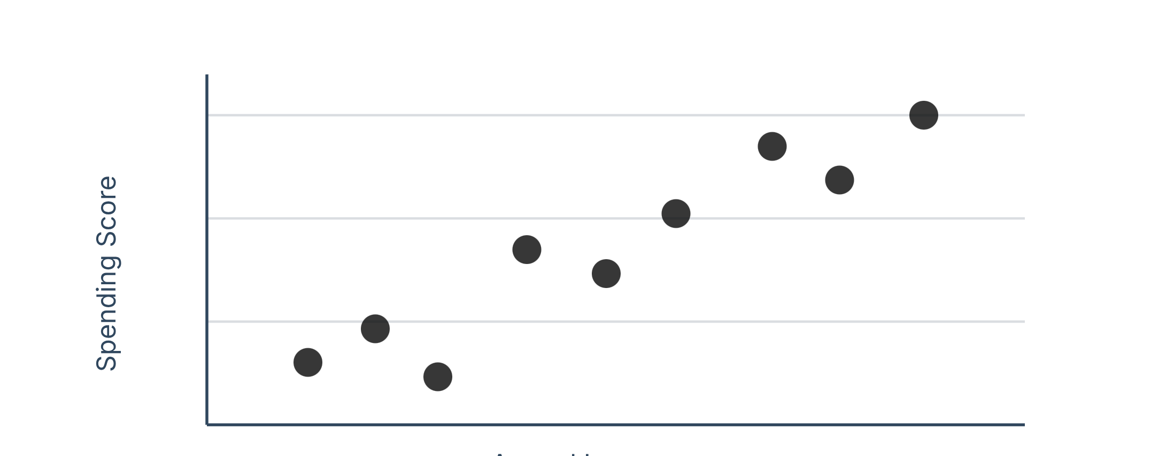
04 · EXPLORATION
Without labels, the data must reveal its own structure.
SUPERVISED LEARNING
Known Labels → Prediction
ILLUSTRATIVE EXPLORATORY VISUAL
Learning from predefined customer labels.
UNSUPERVISED LEARNING
No Labels → Pattern Discovery → Clusters
The algorithm discovers natural patterns and groups customers by similarity.
EDA: dataset shape, descriptive statistics, feature distributions, and Annual Income vs Spending Score.
Illustrative until the dataset is loaded.

Slide 6
05 · THE ALGORITHM
K-Means turns similarity into a repeatable distance calculation.
Simple to understand, fast for numerical data, and interpretable.
Represent each customer as a point in feature space.
Assign nearby points to the same cluster.
DISTANCE AND OBJECTIVE
Euclidean distance
Objective: Minimize WCSS.
xᵢ = customer point · μₖ = cluster centroid · WCSS = within-cluster sum of squares
Customer Points → Distance Calculation → Nearest Centroid

Slide 7
06 · ITERATION
The elbow helps choose a useful value of K.
Select K.
Choose initial centroids.
Calculate distances.
Assign each point to its nearest centroid.
Recalculate centroids.
Repeat until clusters stabilize.
ILLUSTRATIVE ELBOW CURVE · K VS WCSS
K | WCSS
2 | [value]
3 | [value]
4 | [value]
5 | [value]
6 | [value]
7 | [value]
WCSS drops quickly before improvement begins to slow. Selected K: [Selected K]. Values are illustrative only until calculated from the dataset.
Customer Points → Distance Calculation → Nearest Centroid
SIX CUSTOMER POINTS · INCOME VERSUS SCORE
Point | Annual Income (k$) | Spending Score (1-100)
A | [Income] | [Score]
B | [Income] | [Score]
C | [Income] | [Score]
D | [Income] | [Score]
E | [Income] | [Score]
F | [Income] | [Score]

Slide 8
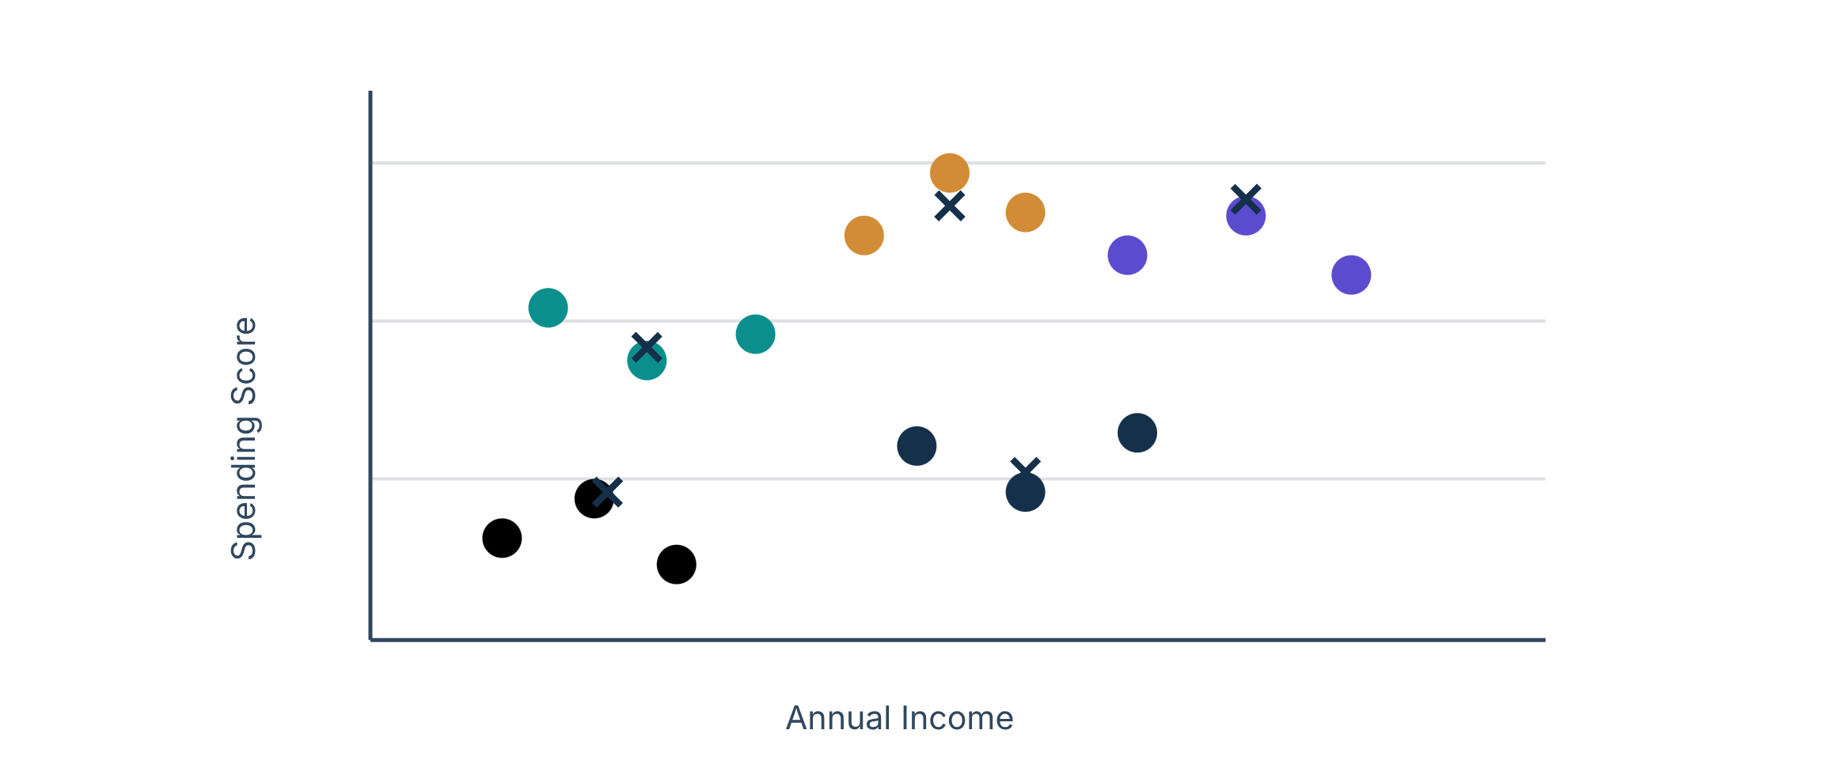
07 · REPRODUCIBILITY
A short pipeline is enough to reproduce the segmentation.
PYTHON IMPLEMENTATION
import pandas as pd
from sklearn.preprocessing import StandardScaler
from sklearn.cluster import KMeans
df = pd.read_csv("Mall_Customers.csv")
X = df[["Annual Income (k$)",
"Spending Score (1-100)"]]
X_scaled = StandardScaler().fit_transform(X)
kmeans = KMeans(n_clusters=5,
random_state=42,
n_init=10)
df["Cluster"] = kmeans.fit_predict(X_scaled)
CLUSTER SCATTER PLOT
Generic cluster colors and centroid markers until actual cluster centers are calculated.

Slide 9
Cluster labels become useful when they become customer profiles.
Cluster | Profile | Pattern
1 | High Value | High income, high spending
2 | Careful | High income, low spending
3 | Budget | Low income, low spending
4 | Potential | Low/medium income, high spending
5 | Average | Moderate income and spending
Loyalty programs
for high-value customers.
Personalized promotions
for potential customers.
Targeted campaigns
for low-spending groups.
Final descriptions must follow the actual calculated cluster centers.
Evaluation: WCSS = [Insert calculated value] · Silhouette Score = [Insert calculated value]
Lower WCSS generally means tighter clusters; higher silhouette indicates better separation.

Slide 10
09 · CONCLUSION
The method is useful, but the assumptions stay visible.
LIMITATIONS
FUTURE SCOPE
Results depend on selected features; K must be chosen.
Initialization and outliers matter; behavior changes over time.
The dataset may not represent every customer.
Add more features; compare DBSCAN or hierarchical clustering.
Use larger real-world data; build an interactive dashboard.
Connect segments to recommendations or campaigns.
Data → Preprocessing → K-Means → Customer Clusters → Business Insights
Final takeaway: Customer segmentation helps businesses understand distinct groups and develop more targeted strategies using data-driven insights.

